Slide 1


Brandon Perez
12/19/2023

Slide 2

Outline
Executive Summary
Introduction
Methodology
Results
Conclusion
Appendix

Slide 3
Executive Summary
In this capstone project, we will predict if the Falcon 9 first stage will land successfully. We collect the data using SpaceX’s REST API and Webscraping from Wikipedia. After data collection, we wrangle the data: renaming columns, replacing missing values, and using classification models to categorize leftover unsorted data. We can then perform EDA using SQL before analyzing the data with visualization techniques. The Folium library is primarily used to gain physical and environment observations. A dashboard is finally prepared to display our results.
The final stage was to fit a model to our cleaned data. The predictions from this model found that as flight number increased, the success rate also increased. Models also found that launch sites are oftentimes located near highways and coasts. After multiple rounds of model training and testing, we concluded that the Decision Tree Classifier gave the highest accuracy on test data for this study.

Slide 4
Introduction
• Project Background and Context:
Space X advertises Falcon 9 rocket launches on its website with a cost of $62M; competitors cost upward of $165M in comparison. Much of these savings stem from Space X’s ability to reuse the first stage. Therefore, if we can determine if the first stage will land, we can determine the cost of a launch. This information can be used if an alternate company wants to bid against Space X for a rocket launch. The goal of the project is to train a machine learning model to predict if the first stage will land successfully or not, and hence determine the approximate cost of the mission as a whole.
• Primary Questions:
§ What factors determine if the rocket will land successfully?
§ How much impact do each of these factors hold?

Slide 5

Section 1

Slide 6
Methodology
Executive Summary
Data collection methodology:
The SpaceX REST API was a primary source for research in this project as well as web scraping Wikipedia
Perform data wrangling
Noise was filtered, missing values were considered, and finally categorical data was one hot encoded for binary classification
Perform exploratory data analysis (EDA) using visualization and SQL
Perform interactive visual analytics using Folium and Plotly Dash
Perform predictive analysis using classification models
Split content into test and training sets, fit the model, and apply to predictive cases

Slide 7
Data Collection – SpaceX API
First, we collect our dataset from the SpaceX API using GET requests in Python. Then, we normalize the JSON contents into a pandas dataframe. Finally, pandas allows us to extract relevant information and clean the data.
From there, the data is ready for figures, model training, or testing.
Retrieve JSON from SpaceX API using GET requests
Convert the JSON to a pandas dataframe
Filter and clean the data for further analysis
Export the data for use in figures or model training

Slide 8
Data Collection – Scraping
Web Scraping proved effective at collecting Falcon 9 historical launch records from a Wikipedia page titled ‘List of Falcon 9 and Falcon Heavy launches.’
We requested the page using the response.get() method and then parsed the data as a BeautifulSoup object. From there, we extracted all column/variable names from the HTML table, and converted them into a dataframe.
Retrieve JSON using requests.get()
Converting the JSON into a BeautifulSoup object
Extracting relevant data from table into a dictionary
Converting the dictionary to a pandas dataframe for further use

Slide 9
Data Wrangling
Exploratory Data Analysis (EDA) was performed on the dataset before wrangling. This included:
• Finding the number of launches at each site.
• Visualizing how many orbits each launch was scheduled to take
• Comparing mission outcomes to their orbit type
Finally, the landing outcome label was created from our Outcome column, with One Hot encoding of 0 denoting failure and 1 denoting successful landing. The cleaned data was exported to a .csv file.

Slide 10
EDA with Data Visualization
Used scatter plots on the following to observe trends between variables
Flight Number and Launch Site
Payload and Launch Site
Flight Number and Orbit type
Payload and Orbit type
Visualized the success rate of each orbit type with a bar chart for clear side to side comparisons.
Visualized the launch success yearly trend using a line plot.

Slide 11
EDA with SQL
We loaded the dataset in IBM Db2 and connected to the database via ibmdb2API. We performed EDA with SQL by executing queries to get insights from the data.
• unique launch sites
• launch sites beginning with CCA
• total payload mass carried by boosters launched by NASA (CRS)
• average payload mass carried by booster version F9 v1.1
• date when the first successful landing outcome in ground pad was achieved.
• The total no of successful and failed outcomes
• names of the booster_versions which have carried the maximum payload mass
• rank of the count of landing outcomes between a specified date.

Slide 12
Build an Interactive Map with Folium
Folium Circles, Markers, Marker clusters, Mouse position and polyline objects were added.
• Circles: To add a highlighted circle area with a text label on a specific site.
• Markers: To mark the site
• Marker Clusters: To simplify the map as it contained any markers having the same coordinate
• Mouse Position: to get the coordinates for the position the mouse points on the map.
• Polyline: to draw a line from a site to the nearest coast, city, highway, etc.

Slide 13
Build a Dashboard with Plotly Dash
Built an interactive Dashboard using Plotly Dash having the following features:
- Added a dropdown for the site input, and plotted a pie chart to view the relative success and failures in launches for each site
- Added a Range Slider for the Payload range to view the scatterplot between Payload and Class, according to the input site and within the provided payload range.
These plots and interactions allowed to quickly visualize and analyze the relation between payloads and launch sites, which helped to find the best site for launching Falcon 9

Slide 14
Predictive Analysis (Classification)
The features/predictor variables and the label/target variable were loaded into respective dataframes. The predictor data was standardized using standar scalar. The data was split into training and test data. The labels are the data that we want to predict. The labels are in the column labeled "class". The features are all the other columns. For the problem statement, classification models such as logistic regression, SVM, DecisionTrees, and KNN were used. We determined the best hyperparameters using GridSearchCV with 10 fold cross validation We also plotted the confusion matrices for each model. We will use the test data to determine which machine learning model performs the best using confusion matrices and scores, then compile the results.
Loading the dataset and standardizing
Splitting into training and testing sets
Model training and hyperparameter tuning
Model Evaluation
Results

Slide 15
Results
Exploratory data analysis results
• Newer rockets could carry more payload
• Payloads over 8000kg have high success rate
• the success rate since 2013 kept increasing till 2020
• 2010-2013 period had no success rate
• Space X uses 4 different launch sites
• VLEO orbit has 14 launches and 85% success rate
• The first successful landing outcome was in 2015, five years after the first launch.
• With booster F9, almost every mission outcome was successful.
• around 70 landing outcomes were successful, while there were 22 no attempts, and around 10
failed.
• With time, the success increased mostly due to advancement in technology.

Slide 16

Section 2

Slide 17
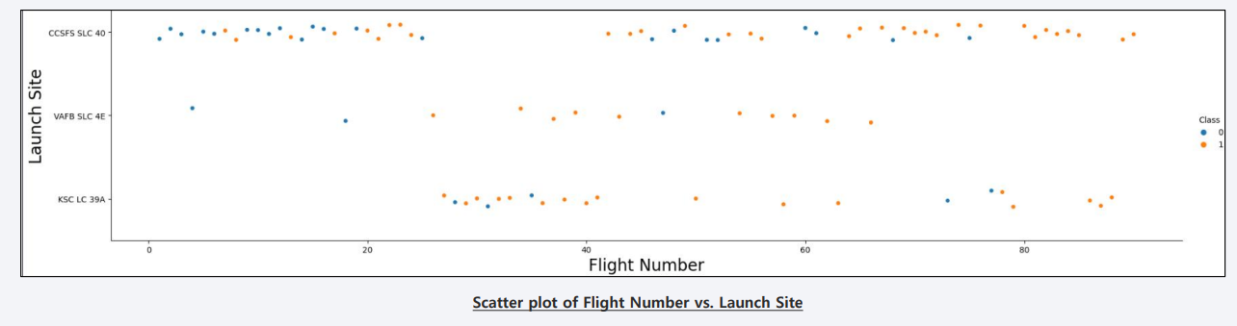
Flight Number vs. Launch Site
Observations:
• CCAFS LC-40 has overall lower success rate than other two as it failed a lot during initial flights
• KSC LC-39A and VAFB SLC 4E have almost same success rate, and they have a relatively higher flight number so failure rate is low
• Best Site is CCAFS SLC-40 as it has very high success rate in recent times.

Slide 18
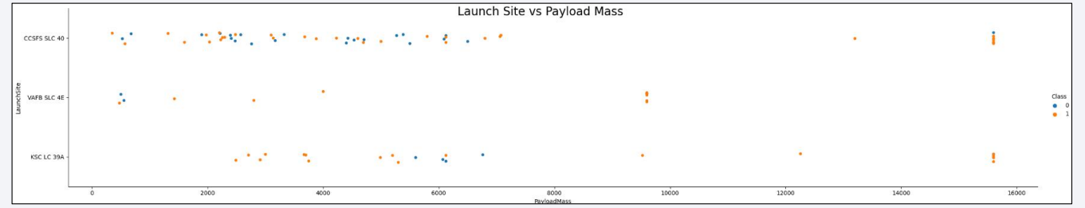
Payload vs. Launch Site
Observations:
• There are no rockets launched for heavy payload mass (greater than 10000) for the VAFB-SLC launchsite A
• Payloads over 8000kg have high success rate
• Payloads less than 6000kg have high failure rate for the CCAFS SLC-40 launch site

Slide 19
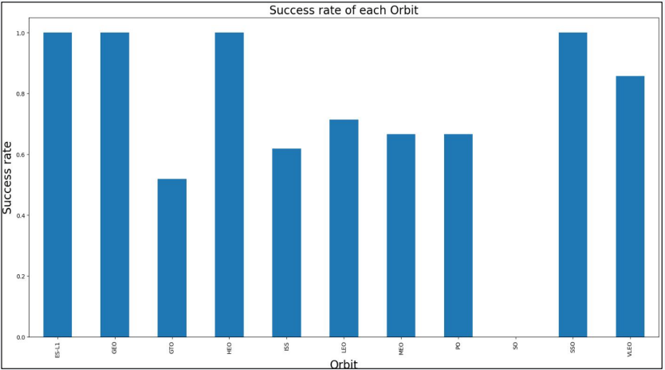
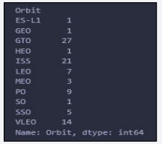
Success Rate vs. Orbit Type
Observations from Data and Bar Chart:
• GEO, HEO, ES-L1, SSO have 1 launches and 100% success rate
• SO has 1 launch and 0% succes rate
• ISS has 21 launches 61% success rate
• VLEO has 14 launches and 85% success rate
• PO has 9 launches and ~65% success rate

Slide 20
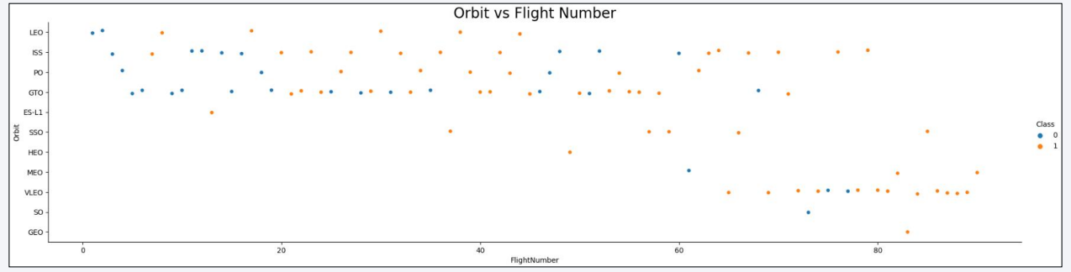
Flight Number vs. Orbit Type
Observations:
• We can see that in the LEO orbit the Success appears related to the number of flights; on the other hand, there seems to be no relationship between flight number when in GTO orbit.
• Success rate is low for the first flight and it increases as the flight number increases

Slide 21
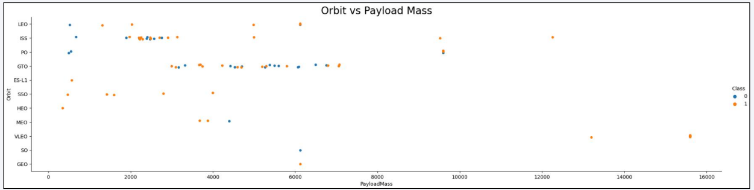
Payload vs. Orbit Type
Observations:
• With heavy payloads the successful landing or positive landing rate are more for PO, LEO and ISS orbits.
• However for GTO we cannot distinguish this well as both positive landing rate and negative landing (unsuccessful mission) are both there here.

Slide 22
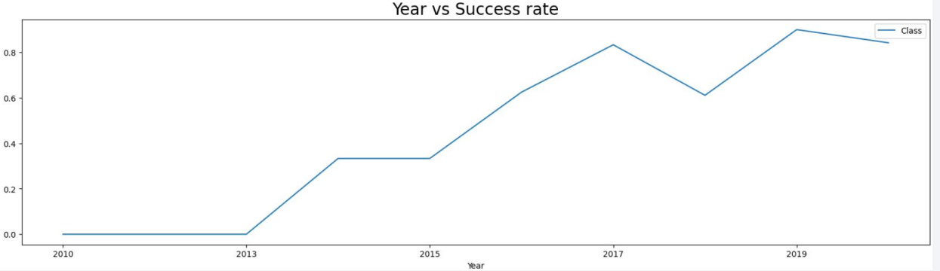
Launch Success Yearly Trend
Observations:
• The success rate since 2013 kept increasing till 2020
• 2010-2013 period had no success rate

Slide 23
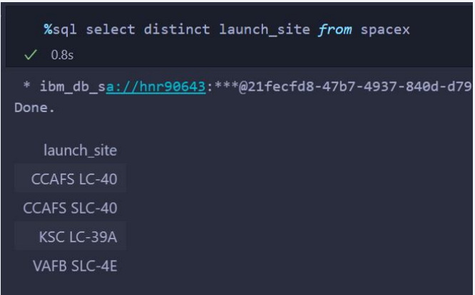
All Launch Site Names
These are the site names queried from the database using “Distinct” Keyword

Slide 24
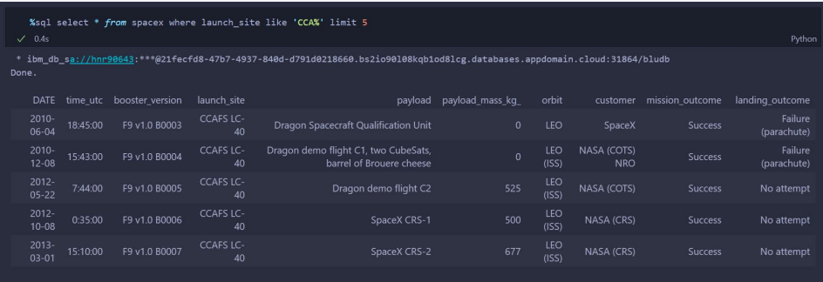
Launch Site Names Begin with 'CCA'
Used the like operator and limit keyword to display only 5 records, of site names beginning with CCA

Slide 25
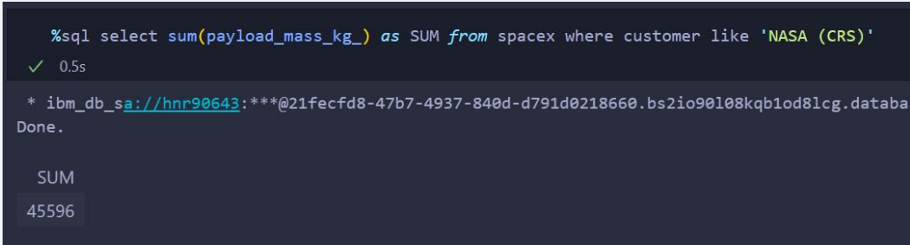
Total Payload Mass
The total payload carried by boosters from NASA (CRS) using the like operation

Slide 26
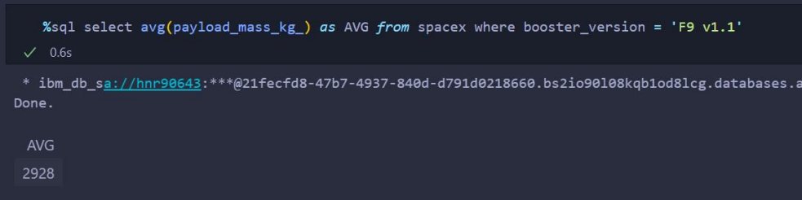
Average Payload Mass by F9 v1.1
The average payload mass carried by booster version F9 v1.1is found out using the ‘ = ’ operator and avg() aggregate function as shown above.

Slide 27
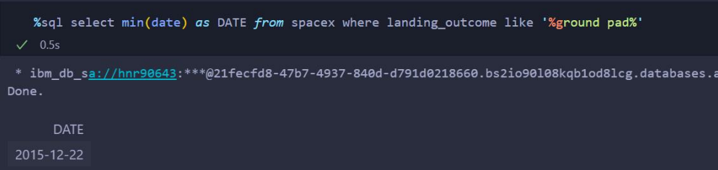
First Successful Ground Landing Date
The date of the first successful landing outcome on ground pad is found out using the min() aggregate function and like operator

Slide 28
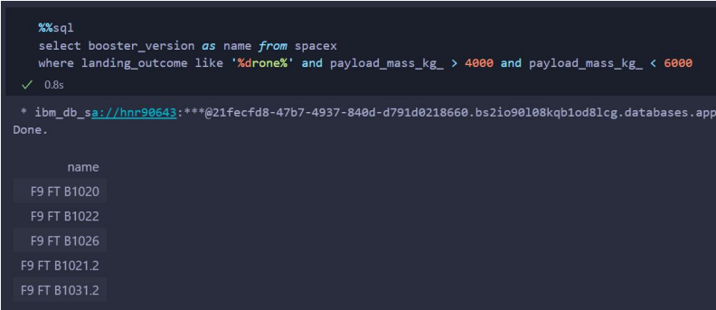
Successful Drone Ship Landing with Payload between 4000 and 6000
We used the where clause to filter for boosters which have successfully landed on drone ship and applied the and condition to find the query result.

Slide 29
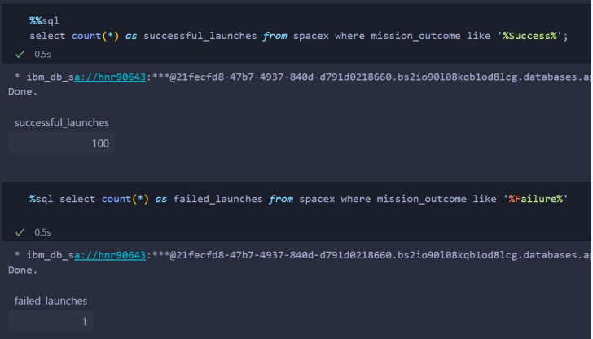
Total Number of Successful and Failure Mission Outcomes
used count() aggregate function and where clause to find total number of successful and failed outcomes.

Slide 30
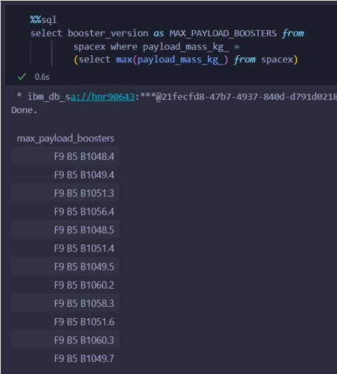
Boosters Carried Maximum Payload
Used a subquery to calculate the max payload and then used = operator to filter the queries

Slide 31
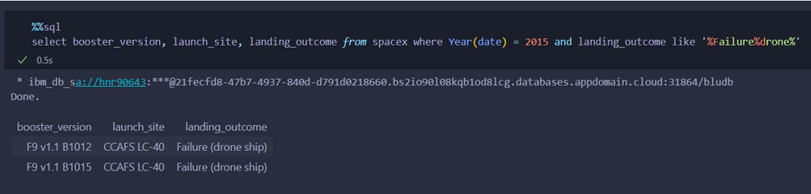
2015 Launch Records
The failed landing_outcomes in drone ship, their booster versions, and launch site names for in year 2015 is found out using the ‘Year()’ function, ‘and’ condition and ‘like’ operator

Slide 32
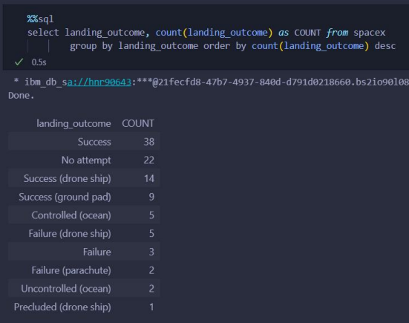
Rank Landing Outcomes Between 2010-06-04 and 2017-03-20
The query to rank the count of landing outcomes (such as Failure (drone ship) or Success (ground pad)) between the date 2010-06-04 and 2017-03-20, in descending order is shown beside:

Slide 33

Section 3

Slide 34
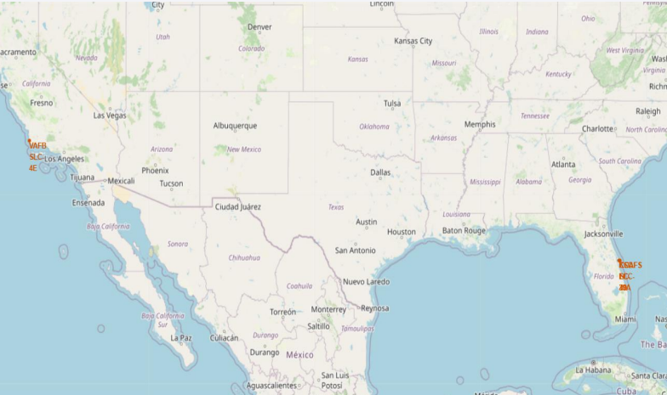
Map Showing All Launch Sites
The map shows all the sites of Falcon 9 launch.
• We can see that the sites are located very close to the coastline as the failure rates of rockets are high (about 5-10%) and civilian areas must be avoided.
• 3 launch sites are located on the east coast of the US and 1 on the west coast
• all the sites are located close to the equator as it takes less fuel to launch a rocket from the equator

Slide 35
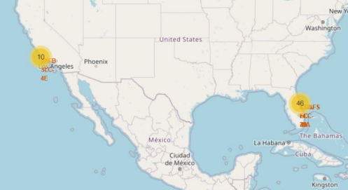
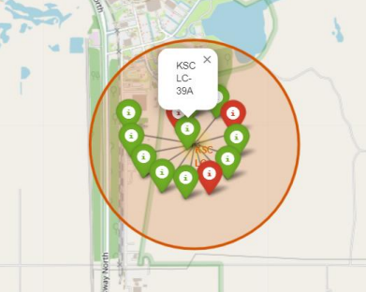
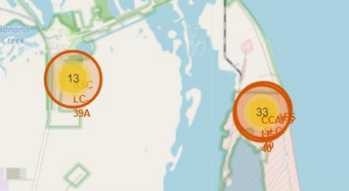
Map Showing the No. of Launches per Launch Site
From the color-labeled markers in marker clusters, it can be easily identified which launch sites have relatively high success rates. The green markers show successful launches and red markers show unsuccessful ones.
Most launches happen on the east coast

Slide 36
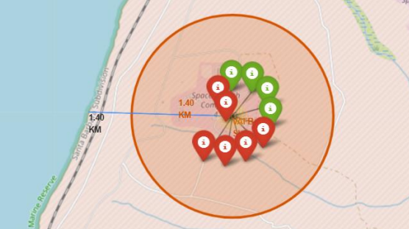
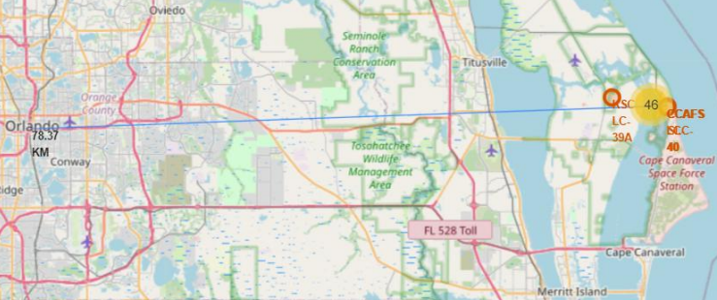
Map Showing Distance of Sites from near by Physical Features
Marked the distance of site with the west coast, and calculated the distance of site from Orlando
We can observe that:
• launch sites are in close proximity to railways, highways, coastline
• Launch sites keep certain distance away from cities

Slide 37

Section 4

Slide 38
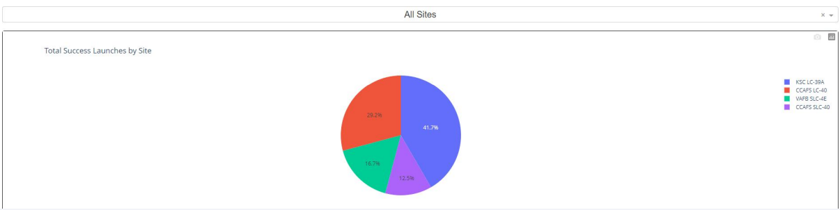
Launch Success Count Ratio for all Sites
The pie chart shows the ratio of the count of successful launches for all sites. We can see that KSC LC-39A has the highest no of successful launches of all sites. CCAFS SLC-40 is the runner up in terms of successful launches.

Slide 39
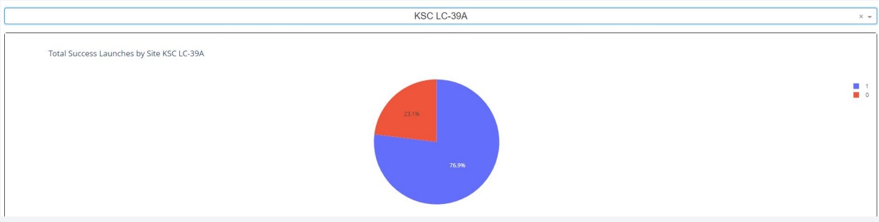
Launch Site with Highest Success Ratio
The KSC LC-39A has the highest no of successful launches of all sites, and this pie chart shows the success and failure share. We can see that it has 76.9% success rate.

Slide 40
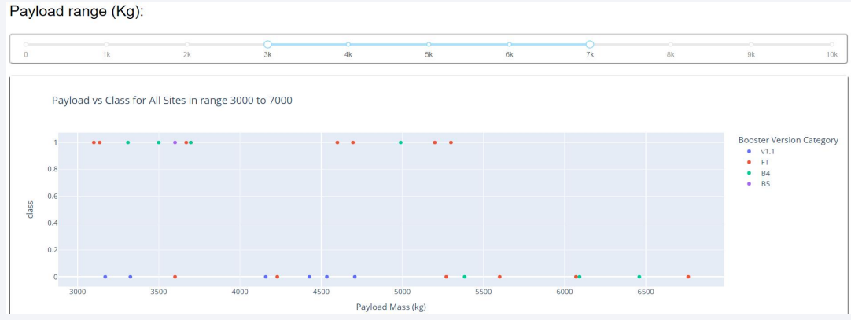
Payload vs Launch Outcome For All Sites
Payload Range 3000 to 7000 kg is selected:
• Explain the important elements and findings on the screenshot, such as which payload range or booster version have the largest success rate, etc.
• B4 booster has high success rate
• FT booster has average success rate while having a high failure rate for

Slide 41

Section 5

Slide 42
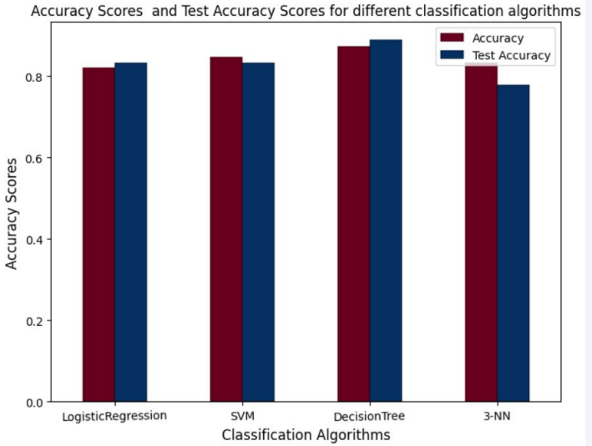
Classification Accuracy
Visualized the accuracy of all classification models used in the project in a bar chart, as in the figure beside: We can see that Decision Tree Classifier has the highest accuracy, while KNN with K=3 has the lowest accuracy score.

Slide 43
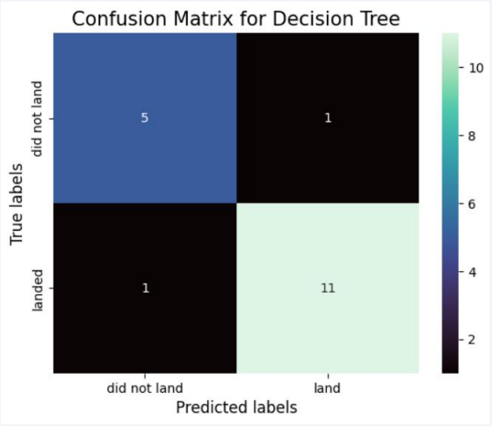
Confusion Matrix
The confusion matrix shows high number of true positive and true negative compared to the false ones.
The Decision Tree correctly classified 16 test points and misclassified only 2 test data points.

Slide 44
Conclusions
The conclusions drawn from the project are:
• The best launch site is KSC LC-39A
• Launches with payloads over 8000kg have high success rate
• VLEO orbit is overall a good choice for launch as it has high success rate for high number of launches
• Failure rate of new launches are low.
• With heavy payloads the successful landing or positive landing rate are more for PO, LEO and ISS orbits.
• Launch sites are located close to the equator, and in close proximity to the coast, railway lines and highways.
• Decision Tree Classifier is the best model for the problem and can be used to predict the success or failure of upcoming launches.

Slide 45


